Slide 1
Part II and III
Things present by Mario
I glaube ebe github fonktioniert ned, wenn mer beidi ah de gliechlige slides schaffe…

Slide 2
Idea and model
Model
Data
Gravity

Slide 3
Idea and model
Model
Data
Gravity

Slide 4
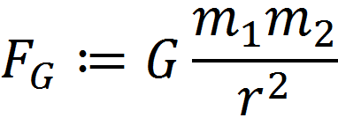
Gravity model

Slide 5
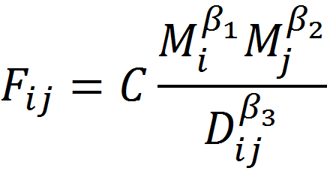
Gravity model

